Slide 1
Biostatistics III Analysis of Categorical Data
Lecture 18: The Multinomial Logistic Regression Model

Slide 2
Outline
Read Hosmer and Lemeshow 8.1.

Slide 3
Introduction
So far we only discussed logistic regression analysis where the outcome variable is binary.
How about if the outcome variable is a nominal variable? For example,
Disease symptoms: absent, mild, moderate, or severe.
Invasiveness of a tumor: In situ, locally invasive, or metastatic.
Option1: dichotomize the multilevel outcome variable.
Disadvantage: loss of details in the outcome variable.
Option2: multinomial logistic regression model.

Slide 4
Example: Mammography Experience Study
Mammography experience study: to assess factors associated with women’s knowledge, attitude, and behavior toward mammography.
Variable Name | Label | Codes/Values
OBS | Identification Code | 1-412
ME | Mammography Experience | 0 = Never 1 = Within One Year 2 = Over One Year Ago
SYMPT | “No need a mammogram unless having symptoms” | 1 = Strongly Agree 2 = Agree 3 = Disagree 4 = Strongly Disagree
PB | Perceived benefit of mammography | 5-20, larger values indicate less belief in the benefit of mammography screening
HIST | Mother/Sister with a history of breast cancer | 0 = No 1 = Yes
BSE | “Anyone taught you how to examine your own breasts: that is BSE?” | 0 = No 1 = Yes
DETC | “ How likely a mammogram could find a new case of breast cancer?” | 1 = Not likely 2 = Somewhat likely 3 = Very likely

Slide 5
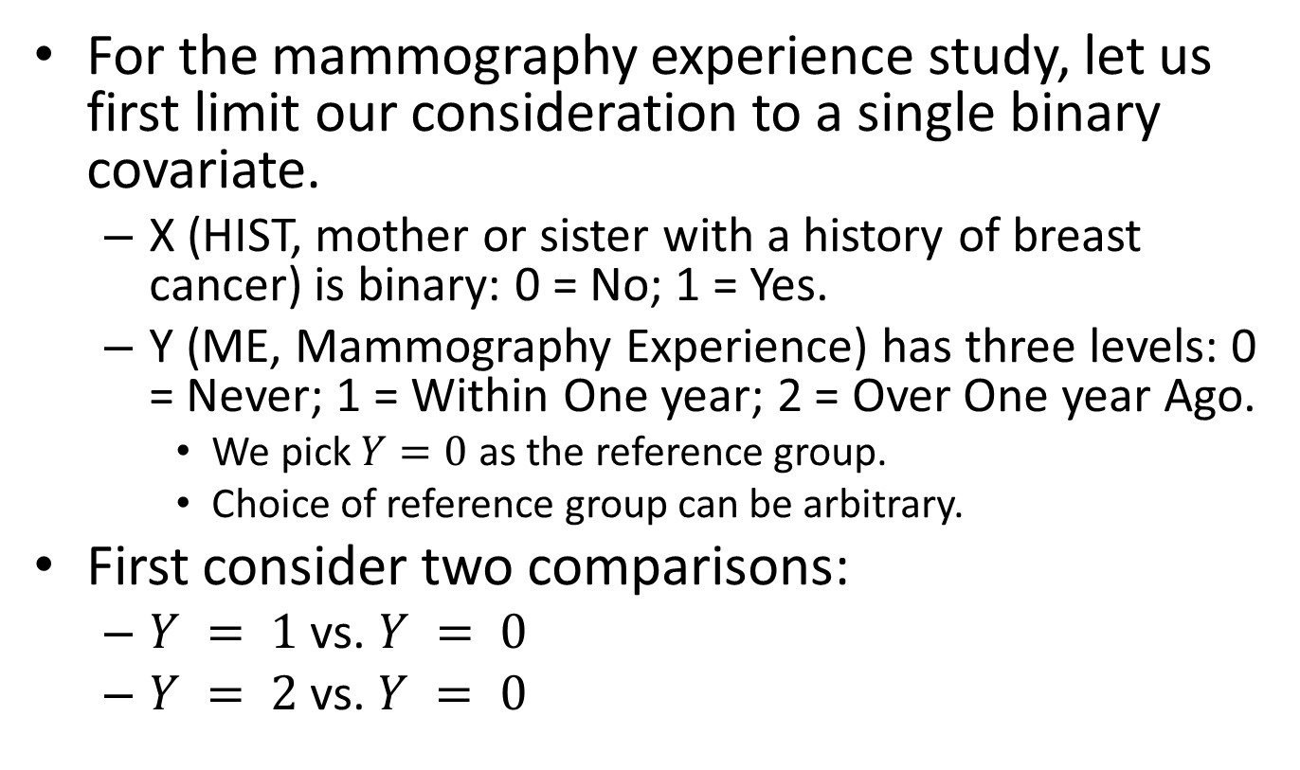
Odds Ratios for Polychotomous Outcome Variable (I)
For the mammography experience study, let us first limit our consideration to a single binary covariate.
X (HIST, mother or sister with a history of breast cancer) is binary: 0 = No; 1 = Yes.
Y (ME, Mammography Experience) has three levels: 0 = Never; 1 = Within One year; 2 = Over One year Ago.
We pick $Y=0$ as the reference group.
Choice of reference group can be arbitrary.
First consider two comparisons:
$Y = 1$ vs. $Y = 0$
$Y = 2$vs. $Y = 0$

Slide 6
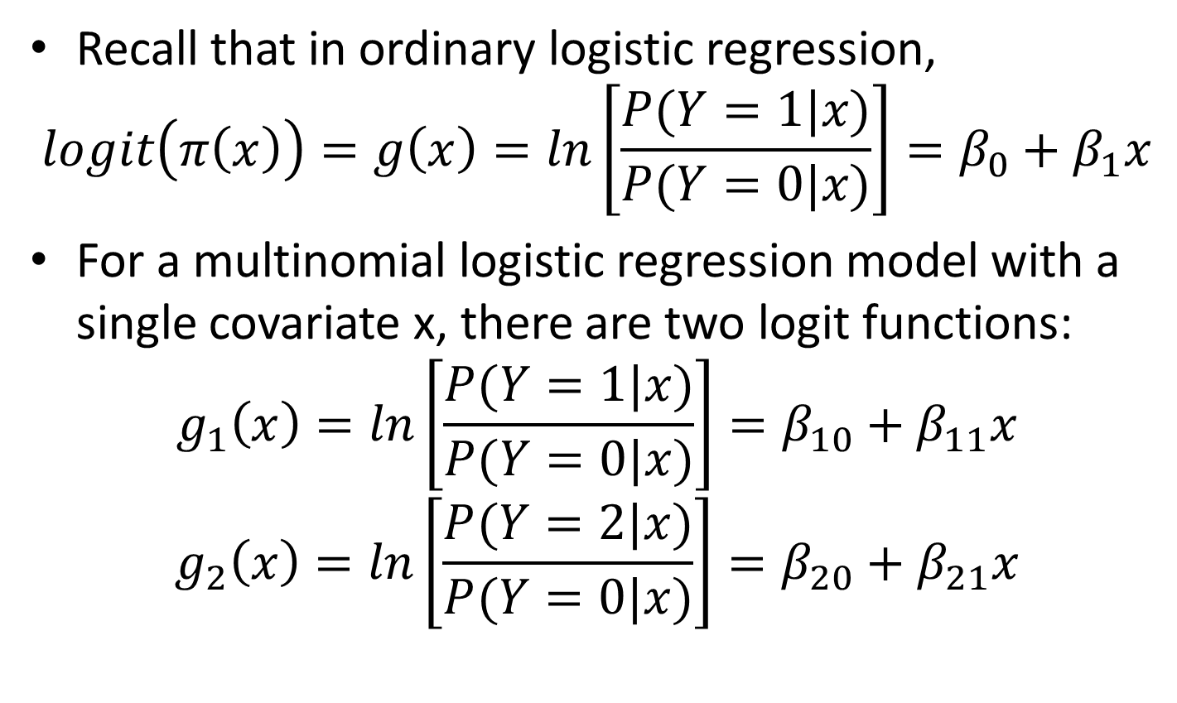
Odds Ratios for Polychotomous Outcome Variable (II)
Recall that in ordinary logistic regression,
$$logit\left(π\left(x\right)\right)=g\left(x\right)=ln\left[\frac{P(Y=1|x)}{P(Y=0|x)}\right]=β_{0}+β_{1}x$$
For a multinomial logistic regression model with a single covariate x, there are two logit functions:
$$g_{1}\left(x\right)=ln\left[\frac{P(Y=1|x)}{P(Y=0|x)}\right]=β_{10}+β_{11}x$$
$$g_{2}\left(x\right)=ln\left[\frac{P(Y=2|x)}{P(Y=0|x)}\right]=β_{20}+β_{21}x$$

Slide 7
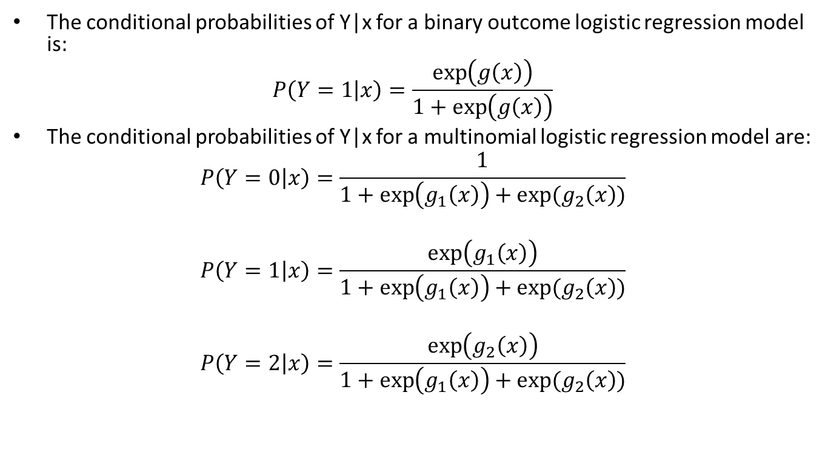
Odds Ratios for Polychotomous Outcome Variable (III)
The conditional probabilities of Y|x for a binary outcome logistic regression model is:
$$P\left(Y=1 | x\right)=\frac{\exp\left(g\left(x\right)\right)}{1+\exp\left(g\left(x\right)\right)}$$
The conditional probabilities of Y|x for a multinomial logistic regression model are:
$$P\left(Y=0 | x\right)=\frac{1}{1+\exp\left(g_{1}\left(x\right)\right)+exp⁡(g_{2}\left(x\right))}$$
$$P\left(Y=1 | x\right)=\frac{\exp\left(g_{1}\left(x\right)\right)}{1+\exp\left(g_{1}\left(x\right)\right)+exp⁡(g_{2}\left(x\right))}$$
$$P\left(Y=2 | x\right)=\frac{\exp\left(g_{2}\left(x\right)\right)}{1+\exp\left(g_{1}\left(x\right)\right)+exp⁡(g_{2}\left(x\right))}$$

Slide 8
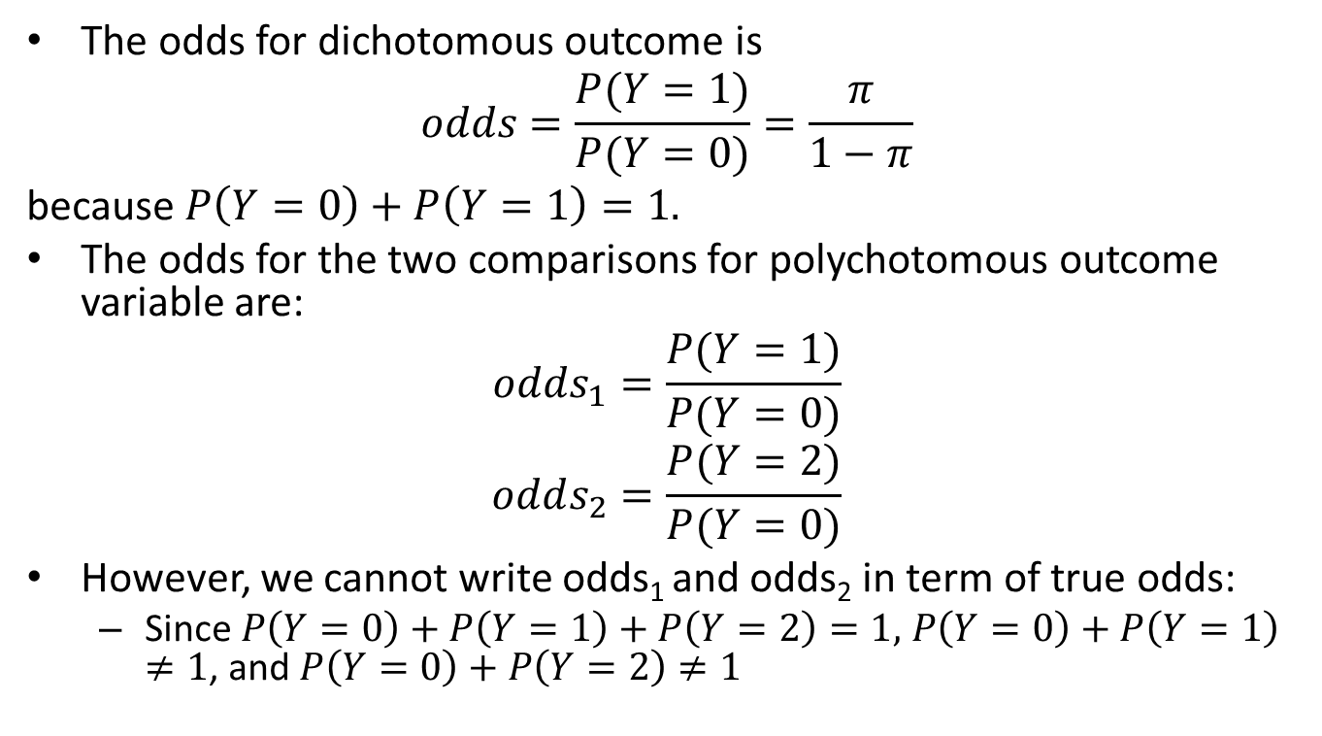
Odds Ratios for Polychotomous Outcome Variable (IV)
The odds for dichotomous outcome is
$$odds=\frac{P(Y=1)}{P(Y=0)}=\frac{π}{1−π}$$
because $P\left(Y=0\right)+P\left(Y=1\right)=1.$
The odds for the two comparisons for polychotomous outcome variable are:
$$odds_{1}=\frac{P(Y=1)}{P(Y=0)}$$
$$odds_{2}=\frac{P(Y=2)}{P(Y=0)}$$
However, we cannot write odds₁ and odds₂ in term of true odds:
Since $P\left(Y=0\right)+P\left(Y=1\right)+P\left(Y=2\right)=1,$ $P\left(Y=0\right)+P\left(Y=1\right)$ $≠1$, and $P\left(Y=0\right)+P\left(Y=2\right)$ $≠1$

Slide 9
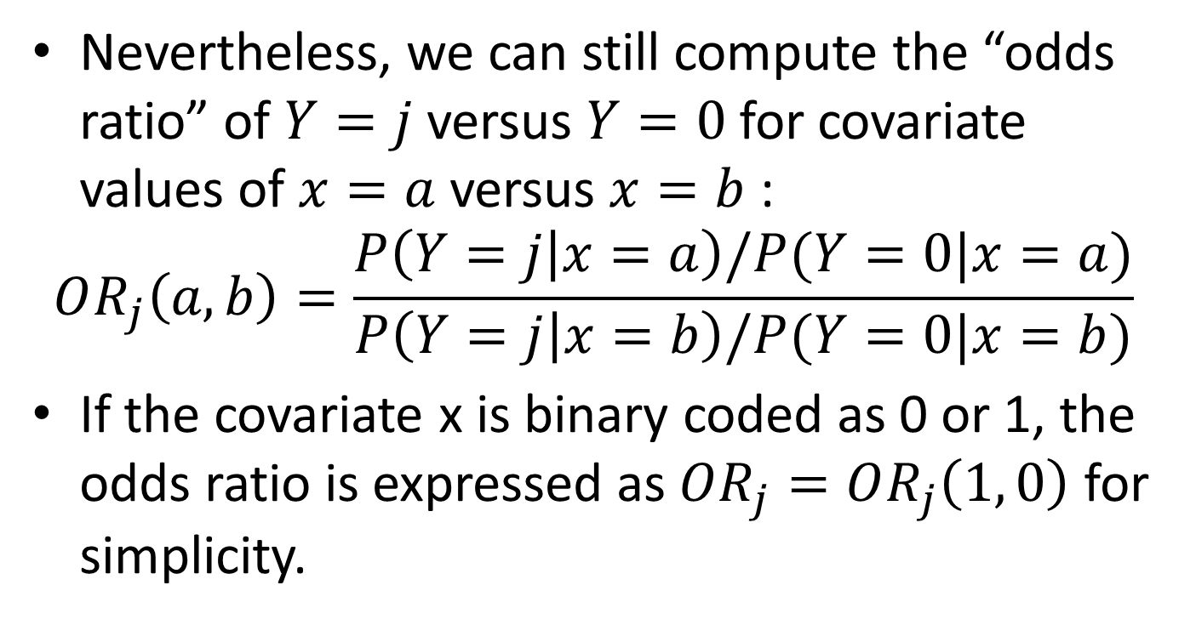
Odds Ratios for Polychotomous Outcome Variable (V)
Nevertheless, we can still compute the “odds ratio” of $Y=j$versus $Y=0$ for covariate values of $x=a$ versus $x=b$ :
$$OR_{j}\left(a,b\right)=\frac{P\left(Y=j | x=a\right)/P(Y=0|x=a)}{P\left(Y=j | x=b\right)/P(Y=0|x=b)}$$
If the covariate x is binary coded as 0 or 1, the odds ratio is expressed as $OR_{j}=OR_{j}\left(1, 0\right)$ for simplicity.

Slide 10
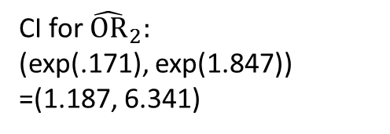

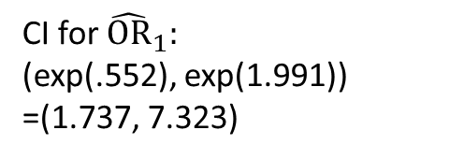



Odds Ratios for Polychotomous Outcome Variable (VI)
$OR_{1}=\frac{220×19}{85×14}=3.51$
$OR_{2}=\frac{220×11}{63×14}=2.74$
 | HIST = 0 | HIST = 1
$$Y=0$$ | 220 | 14
$$Y=1$$ | 85 | 19
$$Y=2$$ | 63 | 11
. mlogit me hist
$${\hat{OR}}_{1}=\exp\left({\hat{β}}_{11}\right)=3.51$$
CI for ${\hat{OR}}_{1}:$
(exp(.552), exp(1.991))
=(1.737, 7.323)
CI for ${\hat{OR}}_{2}:$
(exp(.171), exp(1.847))
=(1.187, 6.341)
$${\hat{OR}}_{2}=\exp\left({\hat{β}}_{21}\right)=2.74$$

Slide 11
SAS Code for Multinomial LR Model
data meexp;
set catclass.meexp;
run;
proc logistic data=meexp;
class me (ref="0");
model me = hist / link=glogit;
run;
Testing Global Null Hypothesis: BETA=0
Test | Chi-Square | DF | Pr > ChiSq
Likelihood Ratio | 12.8581 | 2 | 0.0016
Score | 13.0502 | 2 | 0.0015
Wald | 12.0106 | 2 | 0.0025
Odds Ratio Estimates
Effect | me | Point Estimate | 95% Wald Confidence Limits
hist | 1 | 3.513 | 1.685 | 7.320
hist | 2 | 2.744 | 1.187 | 6.342
Analysis of Maximum Likelihood Estimates
Parameter | me | DF | Estimate | Standard Error | Wald Chi-Square | Pr > ChiSq
Intercept | 1 | 1 | -0.9510 | 0.1277 | 55.4474 | <.0001
Intercept | 2 | 1 | -1.2505 | 0.1429 | 76.5842 | <.0001
hist | 1 | 1 | 1.2564 | 0.3747 | 11.2448 | 0.0008
hist | 2 | 1 | 1.0093 | 0.4275 | 5.5744 | 0.0182

Slide 12
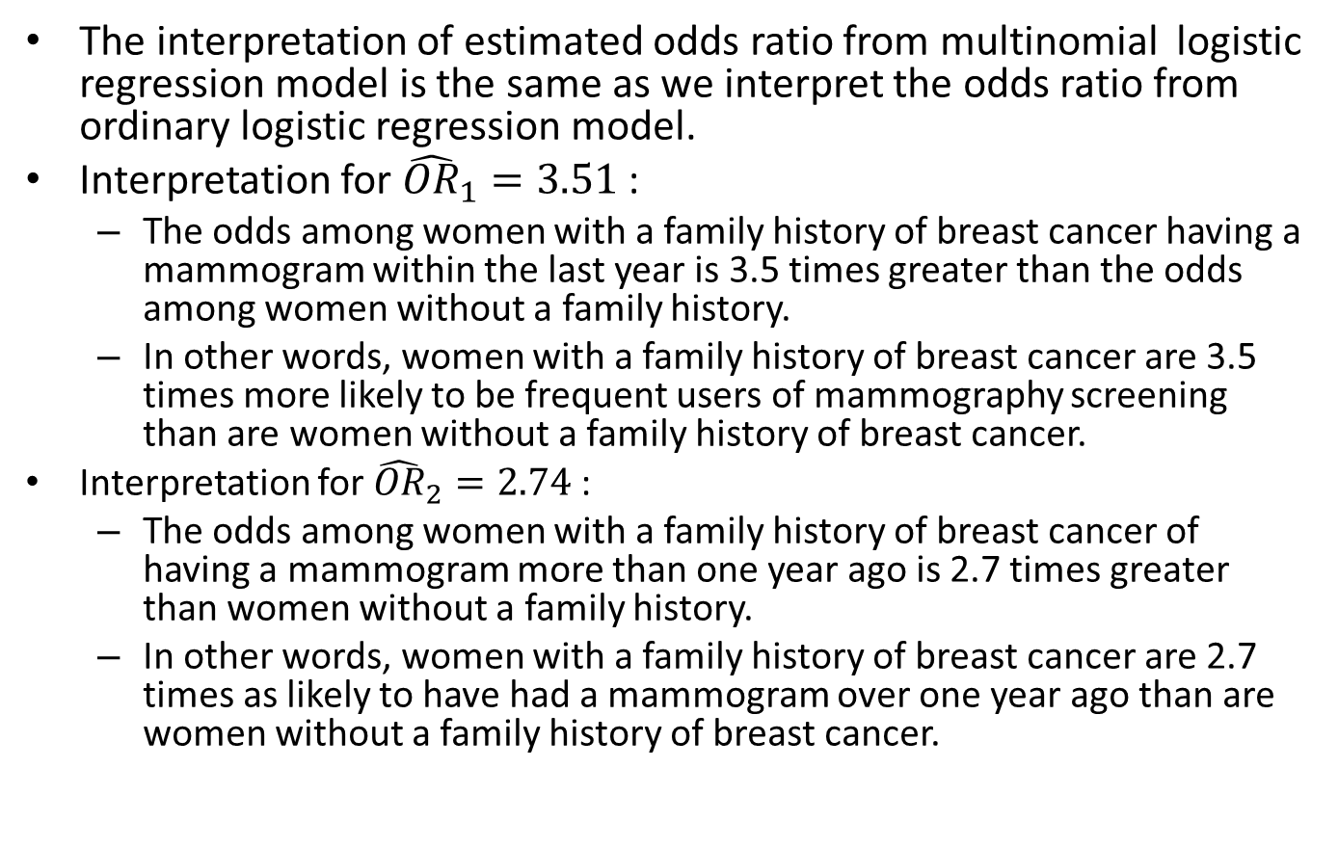
Odds Ratios for Polychotomous Outcome Variable (VII)
The interpretation of estimated odds ratio from multinomial logistic regression model is the same as we interpret the odds ratio from ordinary logistic regression model.
Interpretation for ${\hat{OR}}_{1}=3.51$:
The odds among women with a family history of breast cancer having a mammogram within the last year is 3.5 times greater than the odds among women without a family history.
In other words, women with a family history of breast cancer are 3.5 times more likely to be frequent users of mammography screening than are women without a family history of breast cancer.
Interpretation for ${\hat{OR}}_{2}=2.74$:
The odds among women with a family history of breast cancer of having a mammogram more than one year ago is 2.7 times greater than women without a family history.
In other words, women with a family history of breast cancer are 2.7 times as likely to have had a mammogram over one year ago than are women without a family history of breast cancer.

Slide 13
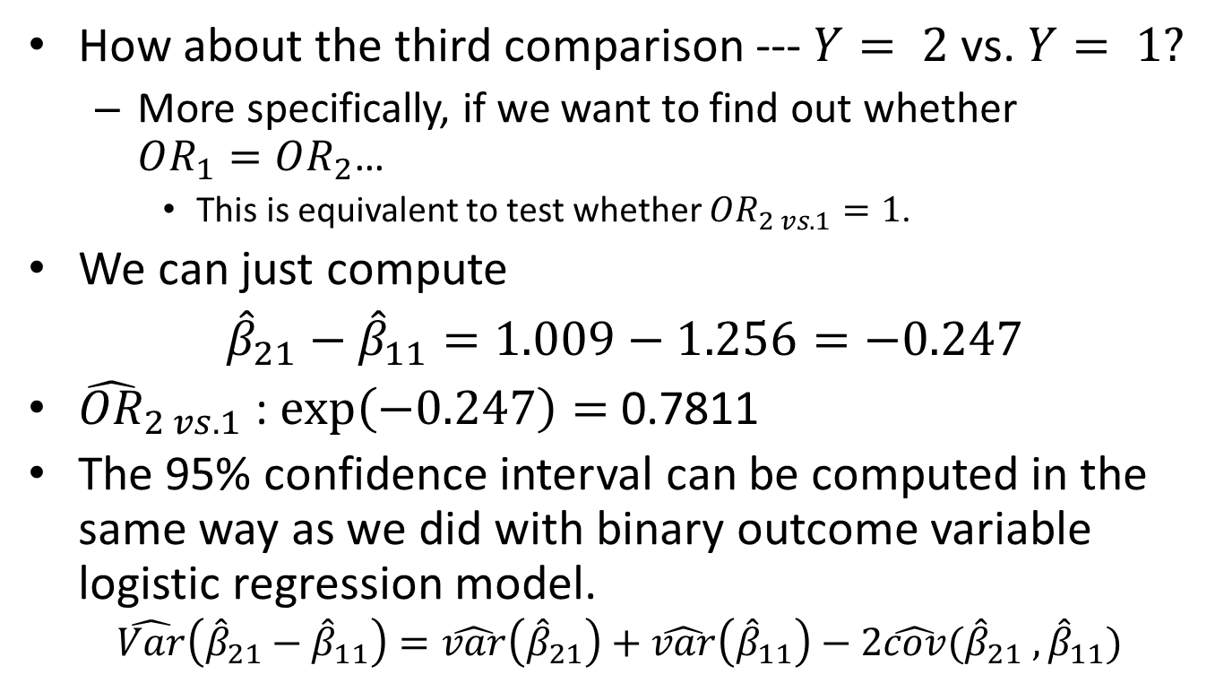
Odds Ratios for Polychotomous Outcome Variable (VIII)
How about the third comparison --- $Y= 2$vs. $Y= 1?$
More specifically, if we want to find out whether $OR_{1}=OR_{2}$…
This is equivalent to test whether $OR_{2 vs.1}=1$.
We can just compute
${\hat{β}}_{21}−{\hat{β}}_{11}=1.009−1.256=−0.247$
${\hat{OR}}_{2 vs. 1}$ : $\exp\left(−0.247\right)=$0.7811
The 95% confidence interval can be computed in the same way as we did with binary outcome variable logistic regression model.
$$\hat{Var}\left({\hat{β}}_{21}−{\hat{β}}_{11}\right)=\hat{var}\left({\hat{β}}_{21}\right)+\hat{var}\left({\hat{β}}_{11}\right)−2\hat{cov}({\hat{β}}_{21} ,{\hat{β}}_{11})$$

Slide 14
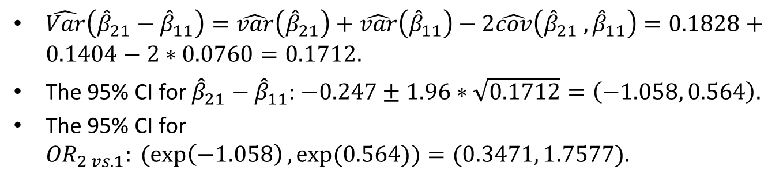
Odds Ratios for Polychotomous Outcome Variable (IX)
$\hat{Var}\left({\hat{β}}_{21}−{\hat{β}}_{11}\right)=\hat{var}\left({\hat{β}}_{21}\right)+\hat{var}\left({\hat{β}}_{11}\right)−2\hat{cov}\left({\hat{β}}_{21} ,{\hat{β}}_{11}\right)=0.1828+0.1404−2∗0.0760=0.1712.$
The 95% CI for ${\hat{β}}_{21}−{\hat{β}}_{11}$: $−0.247±1.96∗\sqrt{0.1712}=\left(−1.058, 0.564\right).$
The 95% CI for ${OR}_{2 vs. 1}:(exp\left(−1.058\right), exp⁡(0.564))=(0.3471, 1.7577).$

Slide 15
SAS Code for Estimating Covariance Matrix
proc logistic data = meexp;
class me (ref="0");
model me = hist /link=glogit covb;
run;
Estimated Covariance Matrix
Parameter | Intercept_1 | Intercept_2 | hist_1 | hist_2
Intercept_1 | 0.01631 | 0.004545 | -0.01631 | -0.00455
Intercept_2 | 0.004545 | 0.020418 | -0.00455 | -0.02042
hist_1 | -0.01631 | -0.00455 | 0.14037 | 0.075974
hist_2 | -0.00455 | -0.02042 | 0.075974 | 0.182756

Slide 16
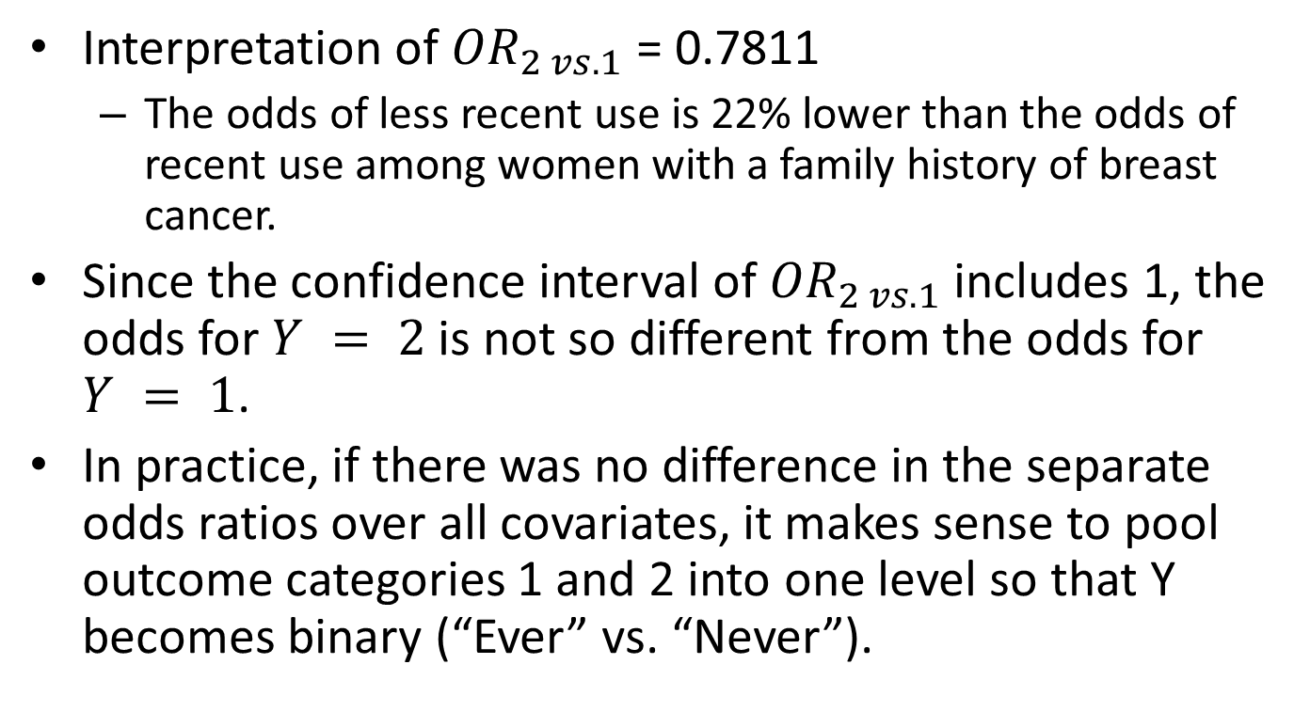
Odds Ratios for Polychotomous Outcome Variable (X)
Interpretation of ${OR}_{2 vs. 1}$ = 0.7811
The odds of less recent use is 22% lower than the odds of recent use among women with a family history of breast cancer.
Since the confidence interval of ${OR}_{2 vs. 1}$ includes 1, the odds for $Y = 2$is not so different from the odds for $Y = 1$.
In practice, if there was no difference in the separate odds ratios over all covariates, it makes sense to pool outcome categories 1 and 2 into one level so that Y becomes binary (“Ever” vs. “Never”).

Slide 17
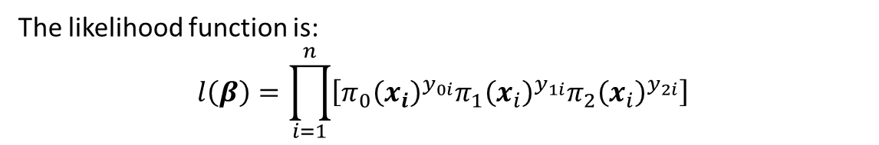
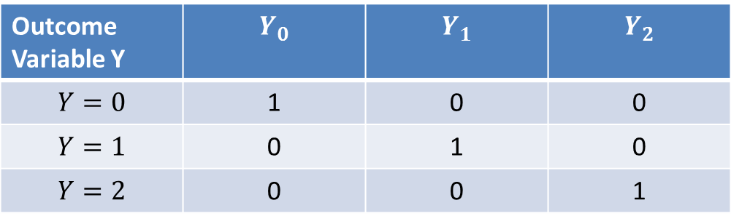
Multinomial Logistic Regression model
To illustrate the likelihood function for multinomial logistic regression model, imagine that we create three binary variables coded 0 or 1 for Y.
The three binary variable coding will not be used in the actual multinomial logistic regression analysis.
Outcome Variable Y | $$Y_{0}$$ | $$Y_{1}$$ | $$Y_{2}$$
$$Y=0$$ | 1 | 0 | 0
$$Y=1$$ | 0 | 1 | 0
$$Y=2$$ | 0 | 0 | 1
The likelihood function is:
$$l\left(β\right)=\prod_{i=1}^{n}{\left[π_{0}{\left(x_{i}\right)}^{y_{0i}}π_{1}{\left(x_{i}\right)}^{y_{1i}}π_{2}{\left(x_{i}\right)}^{y_{2i}}\right]}$$

Slide 18
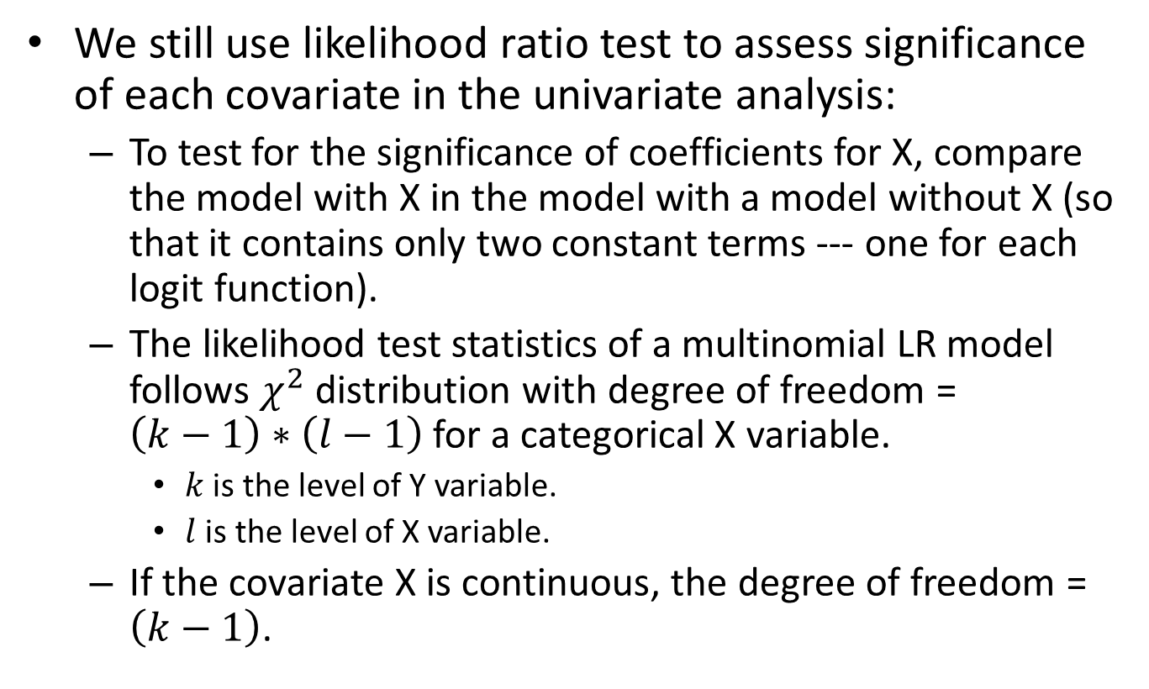
Univariate Analysis for Multinomial Logistic Regression (I)
We still use likelihood ratio test to assess significance of each covariate in the univariate analysis:
To test for the significance of coefficients for X, compare the model with X in the model with a model without X (so that it contains only two constant terms --- one for each logit function).
The likelihood test statistics of a multinomial LR model follows $χ^{2}$distribution with degree of freedom = $\left(k−1\right)∗\left(l−1\right)$for a categorical X variable.
$k$ is the level of Y variable.
$l$ is the level of X variable.
If the covariate X is continuous, the degree of freedom = $\left(k−1\right)$.

Slide 19
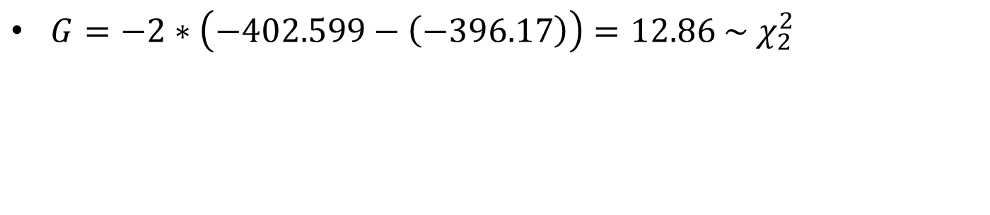
Univariate Analysis for Multinomial Logistic Regression (II)
$G=−2∗\left(−402.599−\left(−396.17\right)\right)=12.86 \sim χ_{2}^{2}$
P-value for Likelihood ratio test.
HIST is significantly associated with a woman’s decision to have a mammogram.

Slide 20
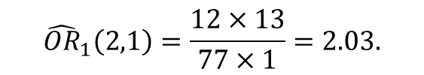
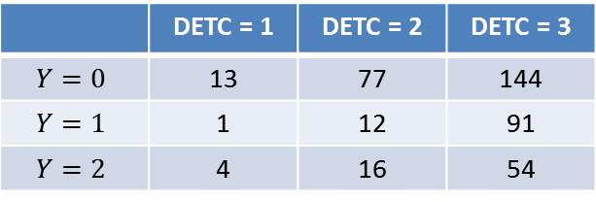
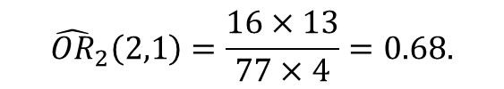
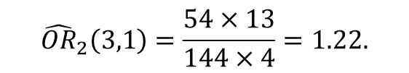
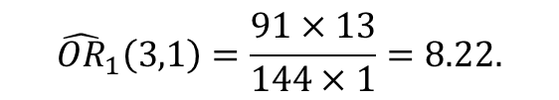
Odds Ratio for Nominal Covariates (I)
The computation and interpretation of odds ratio for nominal covariate is similar…
Consider a covariate variable with 3 levels.
DETC: “ How likely is it that a mammogram could find a new case of breast cancer?”
1 = Not likely (reference); 2 = Somewhat likely; 3 = Very likely.
$${\hat{OR}}_{1}\left(2,1\right)=\frac{12×13}{77×1}=2.03.$$
 | DETC = 1 | DETC = 2 | DETC = 3
$$Y=0$$ | 13 | 77 | 144
$$Y=1$$ | 1 | 12 | 91
$$Y=2$$ | 4 | 16 | 54
$${\hat{OR}}_{1}\left(3,1\right)=\frac{91×13}{144×1}=8.22.$$
$${\hat{OR}}_{2}\left(2,1\right)=\frac{16×13}{77×4}=0.68.$$
$${\hat{OR}}_{2}\left(3,1\right)=\frac{54×13}{144×4}=1.22.$$

Slide 21
Odds Ratio for Nominal Covariates (II)

Slide 22
Odds Ratio for Nominal Covariates (III)
Relative risk ratio

Slide 23




Odds Ratio for Nominal Covariates (III)
$${\hat{OR}}_{1}\left(2,1\right)=\exp\left({\hat{β}}_{11}\right)=2.03$$
$${\hat{OR}}_{1}\left(3,1\right)=\exp\left({\hat{β}}_{12}\right)=8.22$$
$${\hat{OR}}_{2}\left(2,1\right)=\exp\left({\hat{β}}_{21}\right)=0.68$$
$${\hat{OR}}_{2}\left(3,1\right)=\exp\left({\hat{β}}_{22}\right)=1.22$$

Slide 24
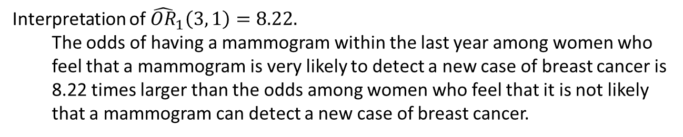
Odds Ratio for Nominal Covariates (IV)
. xi: mlogit me i.detc, rrr
Interpretation of ${\hat{OR}}_{1}\left(3, 1\right)=8.22.$
The odds of having a mammogram within the last year among women who feel that a mammogram is very likely to detect a new case of breast cancer is 8.22 times larger than the odds among women who feel that it is not likely that a mammogram can detect a new case of breast cancer.

Slide 25
Odds Ratio for Nominal Covariates (V)
How about if we want to compare the two sets of odds ratios over the responses of DETC to determine whether the two logit functions are different.
Conclusion: For DETC we should not combine the ME=1 and ME=2 outcome categories.

Slide 26
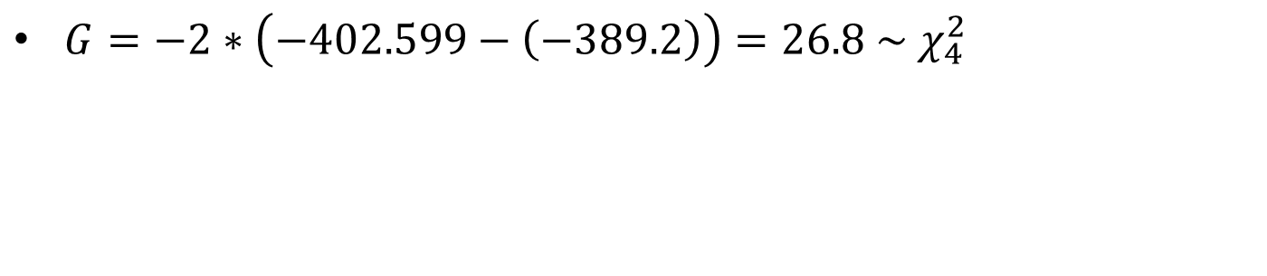
Univariate Analysis for Multinomial Logistic Regression (III)
$G=−2∗\left(−402.599−\left(−389.2\right)\right)=26.8 \sim χ_{4}^{2}$
P-value for Likelihood ratio test.
DETC is significantly associated with a woman’s decision to have a mammogram.

Slide 27
SAS Code for Multinomial LR
proc logistic data = meexp ;
class me(ref="0") detc (ref="1") / coding = reference;
model me = detc /link = glogit;
run;
Odds Ratio Estimates
Effect | me | Point Estimate | 95% Wald Confidence Limits
detc 2 vs 1 | 1 | 2.026 | 0.242 | 16.927
detc 2 vs 1 | 2 | 0.675 | 0.195 | 2.341
detc 3 vs 1 | 1 | 8.215 | 1.057 | 63.860
detc 3 vs 1 | 2 | 1.219 | 0.381 | 3.901
Analysis of Maximum Likelihood Estimates
Parameter |  | me | DF | Estimate | Standard Error | Wald Chi-Square | Pr > ChiSq
Intercept |  | 1 | 1 | -2.5649 | 1.0377 | 6.1091 | 0.0134
Intercept |  | 2 | 1 | -1.1787 | 0.5718 | 4.2494 | 0.0393
detc | 2 | 1 | 1 | 0.7060 | 1.0831 | 0.4248 | 0.5145
detc | 2 | 2 | 1 | -0.3926 | 0.6344 | 0.3830 | 0.5360
detc | 3 | 1 | 1 | 2.1059 | 1.0463 | 4.0509 | 0.0441
detc | 3 | 2 | 1 | 0.1978 | 0.5936 | 0.1111 | 0.7389

Slide 28
Modeling Building Strategies for Multinomial LR (I)
Since n = 412 and there are only 5 independent variables, we start with all independent variables in the multiple multinomial LR.
. xi: mlogit me i.sympt pb hist bse i.detc, rrr
Both insignificant, may not want to include the independent variable in the final model.

Slide 29
Modeling Building Strategies for Multinomial LR (II)
SYMPT_2 and the reference group are not so different for both ME = 1 and ME = 2, so may pool SYMPT_2 and the reference group.
Both SYMPT_3 and SYMPT_4 are somehow different from the reference group.
Want to test whether SYMPT_3 = SYMPT_4 within ME =1 and ME = 2.
May pool SYMPT_3 with SYMPT_4

Slide 30
Modeling Building Strategies for Multinomial LR (III)
Shall we re-categorize SYMPT to a binary SYMPTD (combine SYMPT =1 and SYMPT = 2, and combine SYMPT = 3 and SYMPT =4)?
. test ([1]_Isympt_2=0) ([2]_Isympt_2=0) ([1]_Isympt_3= [1]_Isympt_4) ([2]_Isympt_3=[2]_Isympt_4)
( 1) [1]_Isympt_2 = 0
( 2) [2]_Isympt_2 = 0
( 3) [1]_Isympt_3 - [1]_Isympt_4 = 0
( 4) [2]_Isympt_3 - [2]_Isympt_4 = 0
chi2( 4) = 3.58
Prob > chi2 = 0.4657
Suggest that it is OK to combine the two groups.

Slide 31
Modeling Building Strategies for Multinomial LR (IV)
. gen symptd=.
. replace symptd = 0 if sympt == 1 | sympt == 2
. replace symptd=1 if sympt ==3 | sympt == 4
. xi: mlogit me symptd pb hist bse i.detc

Slide 32
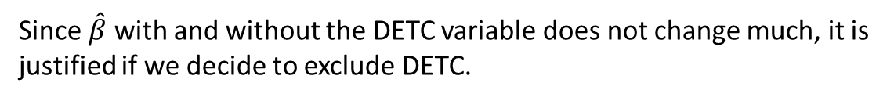
Modeling Building Strategies for Multinomial LR (V)
Shall we exclude DETC or re-categorize DETC?
. xi: mlogit me symptd pb hist bse, rrr
$G=−2\left(−353.019−\left(−348.748\right)\right)=8.5421 \sim χ_{4}^{2},$ P-value = 0.074.
Since $\hat{β}$ with and without the DETC variable does not change much, it is justified if we decide to exclude DETC.

Slide 33
Modeling Building Strategies for Multinomial LR (VI)
Since this data set has only 5 independent variables, shall we re-categorize DETC and assess whether a binary DETC will be an important confounder?
Because the reference group DETC=1 has only 18 observations, we may combine DETC=1 with DETC = 2.
. rename _Idetc_3 detcd
. mlogit me symptd pb hist bse detcd, rrr

Slide 34
SAS Code for Multinomial LR Model
data meexp;
set catclass.meexp;
if sympt = 1 or sympt =2 then symptd = 0;
else symptd = 1;
detcd = (detc = 3);
run;
proc logistic data = meexp;
class me(ref="0") /coding=reference;
model me = symptd pb hist bse detcd/ link = glogit ;
run;

Slide 35
Determine the Scale of a Continuous Covariate in Multinomial LR
Design variable approach may be used.
Alternative will be to separately fit logistic models for each logit.
Then fractional polynomials can be used to find the scale.
After evaluating the scale for the continuous variable PB, we decided to keep the linear form, thus the model in previous slide is determined to be the preliminary final model.

Slide 36
Comments on Fitting Separate LR Models for Nominal Outcome Variables
Another alternative model building strategies for multinomial LR is to fit separate logistic regression models to obtain approximate MLE estimates for a multinomial LR model.
In our ME study example, we can fit two models:
A LR model for Y = 1 versus Y = 0, ignoring the Y = 2 data.
A LR model for Y = 2 versus Y = 0, ignoring the Y = 1 data.
Proposed by Begg and Gray (1984), who showed the estimates of the logistic regression coefficients obtained in separate models are
Consistent.
Under many circumstances not much loss in efficiency.

Slide 37
Assessment of Fit and Diagnostics for the Multinomial LR Model
We may assess the goodness of fit for a multinomial LR model using the individual logistic regressions approach of Begg and Gray.
Then integrate the results descriptively to make a statement about the fit of the multinomial LR model.

Slide 38
Interpretation of Estimated OR (I)
Odds Ratio Estimates
Effect | me | Point Estimate | 95% Wald Confidence Limits
symptd | 1 | 8.121 | 3.313 | 19.902
symptd | 2 | 3.088 | 1.536 | 6.208
pb | 1 | 0.779 | 0.676 | 0.898
pb | 2 | 0.857 | 0.743 | 0.988
hist | 1 | 3.706 | 1.584 | 8.668
hist | 2 | 2.896 | 1.192 | 7.034
bse | 1 | 3.445 | 1.230 | 9.648
bse | 2 | 2.601 | 0.962 | 7.031
detcd | 1 | 2.423 | 1.206 | 4.871
detcd | 2 | 1.121 | 0.601 | 2.091

Slide 39
Interpretation of Estimated OR (II)
 | Mammogram Within One Year versus Never |  |  | Mammogram Over One Year Ago versus Never
Variable | Odds Ratio | 95% CI |  | Odds Ratio | 95% CI
SYMPTD | 8.121 | 3.313 | 19.902 | 3.088 | 1.536 | 6.208
PB | 0.779 | 0.676 | 0.898 | 0.857 | 0.743 | 0.988
HIST | 3.706 | 1.584 | 8.668 | 2.896 | 1.192 | 7.034
BSE | 3.445 | 1.23 | 9.648 | 2.601 | 0.962 | 7.031
DETCD | 2.423 | 1.206 | 4.871 | 1.121 | 0.601 | 2.091
There is an increase in the odds for mammography screening for both frequency of use categories versus the never category except for PB.
For the covariate SYMPTD, women who disagree with the statement “You don’t need a mammogram unless you develop symptoms” are 8.1 times more likely to have had a recent mammogram and 3.1 times more likely to have had a less recent mammogram when compared to women who do not disagree with the statement.

